Slide 1

Findings from 2019 / 2020
Notes:
Two phases of work – this presentation discusses the second phase
Two components – story-gathering and a Citizens’ Jury – will discuss both outlining the methods and key findings

Slide 2
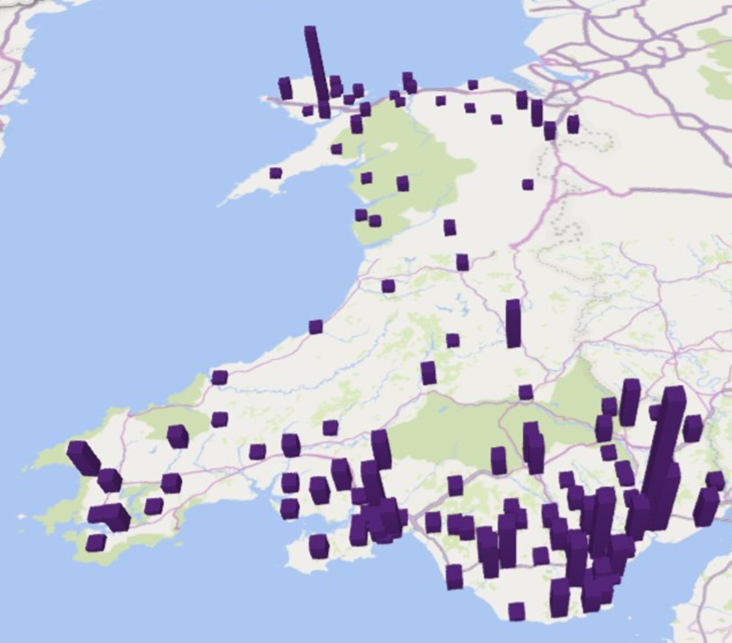
Overview
August 1st 2019 to May 31st 2020
520 stories from 421 individuals
85,000 words
193 people with caring responsibilities
167 disabled people
SenseMaker
Sampling method – chose to invite MtM
Self-selection – chose to participate, chose what to share
Notes:
Be clear about the sampling method – people chose to invite us to events and groups and then individuals chose to speak to us and what they shared – this is valuable approach, leaving it open to people to share what stood out to them. Further detail available in the report. The stories are a snapshot of people’s lives.
Emphasise that this presentation is about what we found on MtM based on what people chose to tell us.
These are Wales-wide findings from a Wales-wide project.

Slide 3
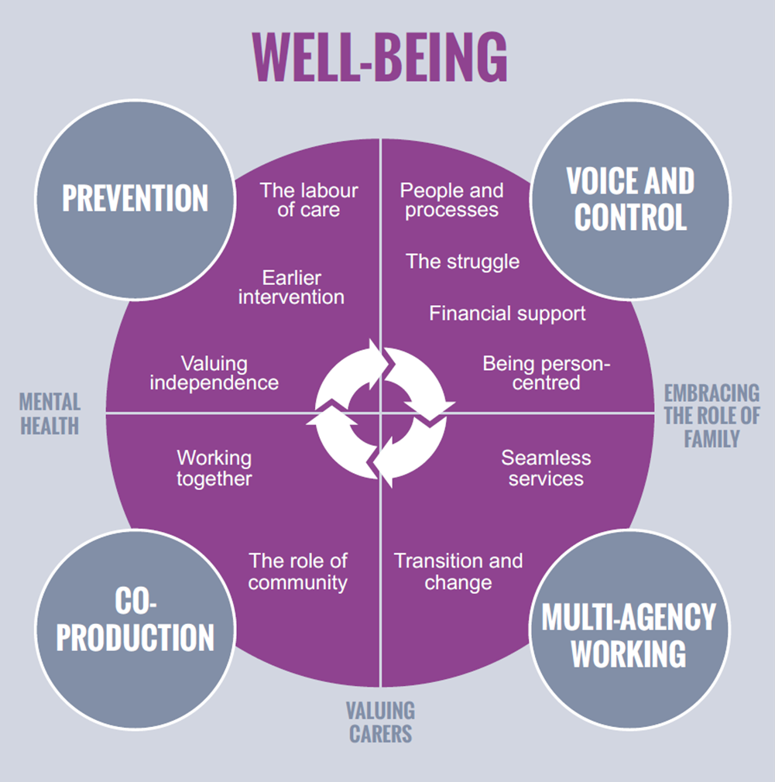
Themes
Stories coded
Themes grouped under the principles of the Act
14 themes - interconnected
Notes:
The stories were read and coded (labelled with specific themes) by three members of Steering Group, these were then grouped to create the framework on the slide.
The themes are all connected and many stories could have sat under several of them.
The complexity of people’s lives and experiences is clear from the stories.

Slide 4
Prevention
I’m really exhausted, constant battle every day. We’ve got a routine, which is lucky, but it’s never ending, always fighting. Getting to my appointments and hers and rearranging. The stigma is terrible, never thought it would be so bad with friends and family - people drift into the background. You get more and more isolated.
I care full time for my partner. I haven’t got any complaints. My partner’s had 3 strokes she’s paralysed on the left hand side. She’s eligible for higher rate PIP - had the assessment and it will be 3 years, or even 5, before the next assessment. [Local authority] fund her care. Her third stroke affected her memory, gave her a type of dementia. The funding will always be there, it took two years to fight for what we needed.
Notes:
Three themes under prevention – the labour of care, earlier intervention and valuing independence.
The stories highlight the incredible efforts made by unpaid carers in support of their family member, friend of loved one. Issues relating to sacrifice, guilt and being side-lined.
Driving force behind their commitment is wanting the person they support to have a good life.

Slide 5
I got to the point where I couldn’t cope (with caring for my children) and did think about suicide - I had no family, no support. I viewed it as my responsibility and when I finally did ask for help there was nothing. My whole life was on show - you feel like a bad person for asking for help…
… Apparently his dementia is not `serious` enough as yet, therefore we have to `just get on with things`, but there is not a day goes by that I come home and something or other has occurred which requires my attention to put right. For instance, he placed our electric cordless kettle on the hob to boil the other day, resulting in a near fire. I am so worried every day and feel so helpless and uninformed.
… What I like about the young adult carers project is that they support you no matter what, even if a caring role ends. One day I knew the youth club was happening and I just turned up as did not want to set expectations that I would attend. It has taken me a long time to realise I do need support and I need to stop being isolated. I tried accessing other services that I thought would help, but they palmed me off or didn't have the right thing for me…Lots of professionals don't take me seriously but [name] who runs the YAC (young adult carer) project does. I am always taken seriously and never forgotten…
Notes:
Lots of missed opportunities to provide people with information or support.
Positive examples of services making themselves available and offering support – being available, listening to people and taking them seriously are vital.

Slide 6
I have arthritis in my hands and was finding things difficult where I lived - cooking was hard and things like hanging the laundry out. I wouldn’t necessarily have had a hot meal whereas here I can have one every day. I also look after my husband and here we get more care - really great help…
I fell last year in my flat. I was in hospital for 5 weeks. I have a new nervousness about going out now. I was glad to come home - I had a lovely welcome. I got back into the routine straightaway. Carers were very good - I needed someone in the flat while I showered, not in the room with me, just in the flat, just to be on the safe side until my confidence came back.
I have been coming to the gardening since last summer. I was referred by a local agency and introduced to the man who runs it. I'm learning to garden, it's a growing interest, and enjoy the small groups. I get to have a chat and have cups of tea. I've been watering the beans and the beetroot. I don't get out much other than this - it’s a lovely a group, really nice, I was made to feel welcome - nice and comfortable and relaxed, it's a good place.
Notes:
Strong correlation between people able to talk about what matters to them and them getting the right support – creating environments and approaches that support this was associate with positive experiences.
Often quite simple or straightforward things made a difference to people.

Slide 7
Voice and Control
I had a GP, she was a fresh young GP and very good. She listened to me and was very person centred, she showed real empathy towards me and was highly respected. She made some referrals for me that lead to me getting the correct treatment I needed, if it wasn’t for her I don’t think I would have got the care I needed. What made her a great GP was she treated me with real respect and as an equal, I was never questioned or made to feel silly. She welcomed my ideas of what I thought was the problem.
I would be absolutely lost without him (my Personal Advisor). He’s always only a phone call away! He keeps his phone on all the time, He is truly amazing. He knows me as a person not just a client - he purposefully empowers me to make decisions, even when I struggle to make a decision... more than anything he is truly honest with me, especially with the difficult conversations and I really appreciate that. Other people might get annoyed but he just tells me how it is.
Notes:
Four theme – people and processes, the struggle, financial support, being person-centred.
Issues of choice were critical.
Lots of positive stories hinged on a particular individual while processes were often seen to be barrier to people getting the right support – see next slide and the struggle

Slide 8
My daughter is peg-fed and this requires a very high level of hygiene. Getting the tube in the right place is complex and the nurse who should be training someone at the school to feed my daughter refuses to do so. She says the nursing guidelines say she cannot deliver this training, even though both the surgeon and consultant my daughter is under have said it’s fine. This means she cannot go to school. I want them to all speak to each other - I’m stuck in the middle, relaying information back and forth…
Just lost a grant that covered domestic help - someone is coming out next week to look at extending the current provision. In renegotiating the care package it may go back out to tender which could mean it moves to a different provider, that I’ll lose [name] (my current carer) and my current arrangements. I really don't want that but it seems to be out of my control.
Used to receive weekly schedule of who to expect. Had two male names one week - no one had asked me if I was okay with that. I rang and said ‘no’ and now I’m down for female only. My care is personal care so I’m surprised men would have been rota’d on. Now I don’t get the rotas but I know there won’t be men on it…
Notes:
The need to battle, fight or struggle for the right support was a theme across a number of stories. People described having no voice, no choices, caught up in circumstances that were out of their control. Often processes were seen to contribute to these negative experiences with people needing to chase appointments, ring people multiple times or finding that their support was being changed in some way due to procedural issues.
Reiteration of straightforward things making a difference eg knowing who is coming into someone’s home.

Slide 9
I employ my own agency using direct payments that come from the local authority but there are fees that come with an agency and I don’t know if these are covered. I’ve been with the same agency for 9 years and I don’t want to change that but I don’t know if the costs will be deemed to be eligible. I used to be able to use my funds towards my carers’ travel costs but now that the WILG (Welsh Independent Living Grant) is with the local authority I don’t know if this is covered by social services now so I may need to pay on top of this.
I have applied for PIP - it took me a while, I got the paperwork but couldn’t face it so it expired. Then I got it again and [name] from our group supported me to fill it in. That was 6 months ago - I have no idea when it’ll get done, I’m assuming it will be rejected. It’s distressing and daunting, like it’s set up to be against you. You haven’t got the energy to fight it, it’s degrading, it’s like you’re asking for the world.
Notes:
Finance was a theme in a number of stories, many of them described confusion or frustration – this was seen again in multi-agency working where decisions about whether costs were social care or healthcare created anxiety and uncertainty for people and often felt unrelated to their actual circumstances.
Experiences of direct payments were varied.
Stories about PIP were almost all incredibly negative and seen to adversely affect people’s mental health.

Slide 10
I moved house recently. The house I was in became unsuitable and I approached my housing association about moving. They offered me a house that was accessible itself but its location was really poor - I would have been really isolated as there's no transport links, no pavements (I use a wheelchair) and no shops nearby and the house was up a hill. I turned it down explaining why and the person I spoke to said 'I'm really disappointed you've turned this down'. Not everyone would be comfortable saying no to something and this kind of attitude doesn't help that. I have now moved to somewhere much more suitable that I like and which is close to transport routes, shops and pubs...
I have carers come in every morning and my wife does the care on the weekends so we can have a lie in, and also in the evening. Generally it's the same carers every day and I get on okay with them. Sometimes I haven't liked someone and I've requested they not come again and that's been fine. They're very good, I can communicate well with them. They're local authority carers so there's always back up if someone is off. I get a rota the week before so I know who to expect. I insisted on that at the beginning and they were fine with that. They do it for those that request it but not otherwise.
Notes:
Being person-centred – a number of stories where processes did not prioritise the needs of the individual; people with fluctuating health conditions or, as yet undiagnosed health conditions described how difficult it could be to get support and others outlined support that failed to meet their individual needs.
More positive experiences described interventions and approaches that could be seen as unremarkable but that made a significance difference to them.
As with other themes, thoughtful human interaction and really listening to people were at the crux of people receiving the right support.

Slide 11
Multi-agency working
All I want now is 2 full time people then I’d be sorted, I’d be able to just crack on. I don’t really need any other help and wouldn’t really need a social workers. With 2 people I’d have cover for leave and sickness from someone I already know really well, and when they were both working I’d have time to go do things and be active. I’ve asked the agency to send the same person as much as possible - I’m sick of the sound of my voice needing to repeat the same thing – I’ve got to live my life with this disability and I don’t want to be talking about it all the time, repeating myself.
I always use hospital transport with my mum - they never pick us up on time and then we have to wait hours and hours to go home. I have to go to hospital next week - because I went on a trip last week I have support hours saved up to put towards going to the hospital and the extra hours the long day / using the transport will need.
Notes:
Two themes – seamless services and transition and change
Strong correlation between people feeling like services had worked together well and them having had a positive experience (and vice-versa)
Working with multiple services was complex and difficult for people; people have to repeat themselves a lot and processes didn’t necessarily support good multi-agency working – reiteration of some of the issues to do with the struggle.
Transport and getting around came through as often overlooked but critical to people being able to engage with services.

Slide 12
…I feel helpless as she deserves to have the most amazing life doing whatever she chooses to do, but I can’t provide it myself. There is nothing in place and [name] finishes in three months. If we lived in Cardiff I know it would be different, but there is nothing in our locality. There are many young people in this area who are in the same boat. This is their community. I’m still waiting for an updated carers’ assessment, which is outstanding. [Name] needs support, twenty four seven, and throughout our time with Children’s Services we had no concerns, there was always support and activities on offer. Now there is not even a youth club, there is absolutely nothing to do in the evening…
After 6 months in hospital, my mum aged 93, along with the family, needed to decide on next steps and started the very complex process of looking at options for support following her hospital discharge. As a very independent lady she was opposed to having carers coming into her home with a key safe and not knowing who would be waking her up or putting her to bed. After 5 months of 4 carers a day and some initial erratic incidents she has settled into the new regime and considers the carers to be kind and patient…
Notes:
Transitions from one service or sector to another were often flashpoints in people’s experiences and often associated with negative experiences. When it was got right, it made a significant difference to people both immediately and longer-term.

Slide 13
Co-production
I have now moved to somewhere much more suitable that I like and which is close to transport routes, shops and pubs. This house though didn't have an appropriate bathroom in it and when I asked the housing association about it they didn't think they could do anything owing to the cost so I asked about getting a disabilities facilities grant which they agreed would be a good solution. I had to chase this up myself. Nobody ever told me what I was entitled to - I had to fight to get the bungalow how I needed it.
Previously my support worker and I could go wherever I wanted but then a change was made that limits his mileage to 14 miles for a round trip. This means, one of the places I liked to go is now slightly too far away - 68p too far away. I suggested that I could pay this to [name] directly and he give me a receipt but that, apparently isn't possible. The extra money would need to go to [organisation] but they would take 50p away before giving the remaining money to [name].
Notes:
Two themes – working together and the role of the community
A number of experiences described decisions being made by professionals without the involvement of the person being supported – a lot of these were negative and outlined similar issues as before in relation to processes, communication and information.
People are prepared to take on responsibilities and want to work with providers if they are given the opportunity to.

Slide 14
This group is a lifeline for me, I don't know what I would do without it. We all live round here, all look out for each other. There are some men who come, and a few different people come on different days. Fish and chips on Thursday, and a quiz. Since my husband died the group's been a lifeline.
Everyone here is really friendly. It’s nice to meet people - nice to mix with friends, and to make new friends. People are very nice - mum and I come every week, my sister drops us off.
This place is very helpful - the communication, you’re bound to see someone you know and you feel better when you leave. It’s good to get out. And the system here is really good, getting to choose your food yourself. And no judgement from anyone.
Notes:
Stories about community support and activities were often very positive. They highlight the importance feeling connected, of meaningful human interactions and often described groups run with little hierarchy that prioritised making people welcome and the sharing of information and support.

Slide 15
Well-being
The staff were not trained to deal with the specific mental health problems of the residents, management did not have the knowledgeable staff with regards to benefits that they said they did, the health board refused to hear my side of the situation, this has resulted in my being afraid now to voice ever again my unhappiness with the system, and I am now left largely unsupported with a serious mental health condition in the community living alone, when if things had gone right it would have been a very different story. Even the supported housing would have been far more successful if the staff and management had been professional and if the housing benefit situation had never happened. It is all a catalogue of disasters, almost like an awful comedy. But the trouble is it is not funny to the people whose lives it ruins.
Notes:
A thread throughout the stories – particularly stands out in relation to mental health needs, valuing carers and the role of the family.
Mental health conditions were described in a number of stories and were often seen to be exacerbated by interactions with services or trying to get the right support. At times this had serious long term consequences

Slide 16
Social services have been to see me twice and there’s been no suggestion of a carer’s assessment. Nothing has been offered to me. I am constantly worried. I have so many appointments for my children to go to and I always worry I may have missed some. I was really worried about post-natal depression - all of this has been discussed with the social services and they have not done anything.
My mum died about 12 years ago then my dad went really downhill. I haven’t been able to grieve for my mum because of how much care my dad needs. He lives with me - he goes for respite now a bit more - booked in for June, July and August for a week at a time, because he’s been going there for a while it’s easy. I book ahead - some places won’t let you do that.
We can’t just say we want to go somewhere, we can’t go away. And you wouldn’t want to be away in case something happened. People don’t like respite - there are only 5 beds and most are for emergency - it’s booked 6 months ahead. They couldn’t fit all my nights of respite in because of how many people need the service, and you don’t necessarily get them back or rolled over if you can’t take them. You book 6 months ahead but anything can change in 6 months.
Notes:
Carers assessments – still very inconsistent and not always leading to the support that’s needed.
Respite was seen as incredibly valuable but could be difficult to access or inflexible.
Both important forms of support that don’t always meet people’s needs.

Slide 17
My daughter and I care for each other. If my hands aren’t working she has to feed me, give me medication - my hands and arms paralysed up the elbow, I can’t move them at all. The pain is excruciating…but my daughter has her own things she finds difficult, she has mental health problems. She and I live together - she has mental health problems (and I have arthritis). She is very up and down. When she kicks off, she really kicks off, and it’s me that she goes to. At the end of the day, how do you manage that? Especially if I’m ill. We have access to the crisis team, and they will talk to me if needed, but she’s not under a psychiatrist. Isn’t that what mums do?
The isolation is so hard. You’re not a normal family, you can’t invite people over, it’s difficult for the children who don't have additional needs - I know one of them feels resentful. It’s a lonely experience when you’re constantly battling for one child, the others are neglected somewhat…
Notes:
A number of stories described people in families caring for one another and / or caring for family members while managing their own health issues. They highlight the complexity of many people’s lives and the lengths people will go to, or have to go to, to secure support or manage the situation themselves.

Slide 18
Conclusions from the stories
Meaningful human interaction is paramount
Core behaviours and approaches include
- working closely with people as equals
- listening to what people say
- supporting individuals to explore what well-being means to them
Restoring, embedding and nurturing humanity within approaches to providing care and support services is critical
The struggle to access support must be eliminated
Notes:
Mention the database of 450+ stories so people can read the material first hand.

Slide 19
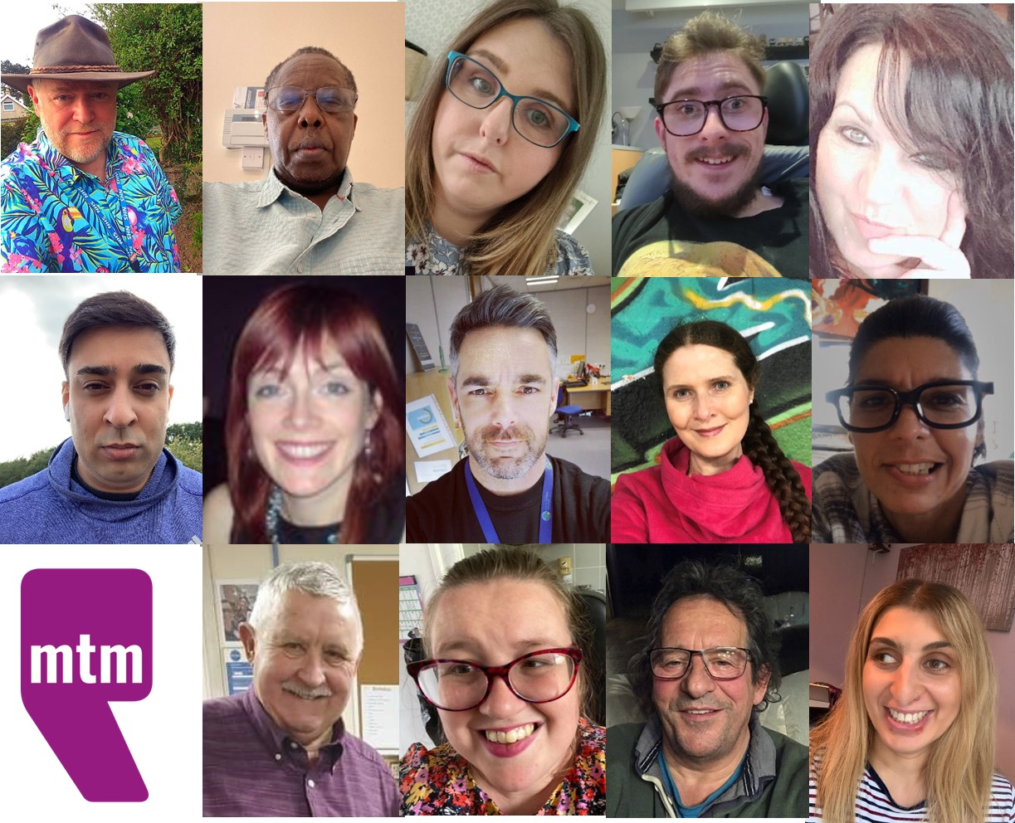
Jurors
14 members of the public
Randomly selected from 125 who registered
Four public days
16 recommendations – policy, people, process and practice
Notes:
The number of people who registered is a fantastic testament to people’s interest in being involved in these kinds of process.

Slide 20
Citizens’ Jury Recommendations
Doing what really matters in social care in Wales: how can we make it happen together?
  Disabled People’s Commissioner
  Redefine Respite Care
  Co-produced Training
  Better Representation
  Direct Payments
Notes:
Direct people to www.mtm.wales and to then click through to watch the sessions on YouTube, read the reports etc.
Encourage implementation of the recommendations.

Slide 21
Further info
For all the reports, recommendations, database of 450+ stories and links to YouTube visit:
www.mtm.wales / www.mym.cymru

